Slide 1
General Overview
Overall PCA Stability and Interpretation
The explained variance ratios remain stable across rolling windows, indicating a persistent and robust factor structure.
PC1 consistently explains between 59% and 72% of total variance and captures a structural contrast between industrial/real-economy attention and consumer/technology-driven narratives.
PC2 explains a smaller but stable share of variance and reflects rotating dynamics between market-driven attention and macro-economic stress narratives.
PC3 contributes marginally to total variance and appears to capture short-lived or residual attention shifts.
Overall, the PCA results suggest that Google search activity contains both structural and narrative-driven dimensions of investor attention.

Slide 2
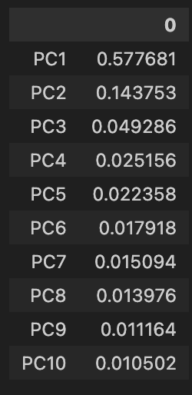
In the sample information
In the sample analysis, we observe the following explained variance ratios:
Does this structure remain stable over time, or do PC1 and PC2 vary across periods?

Slide 3
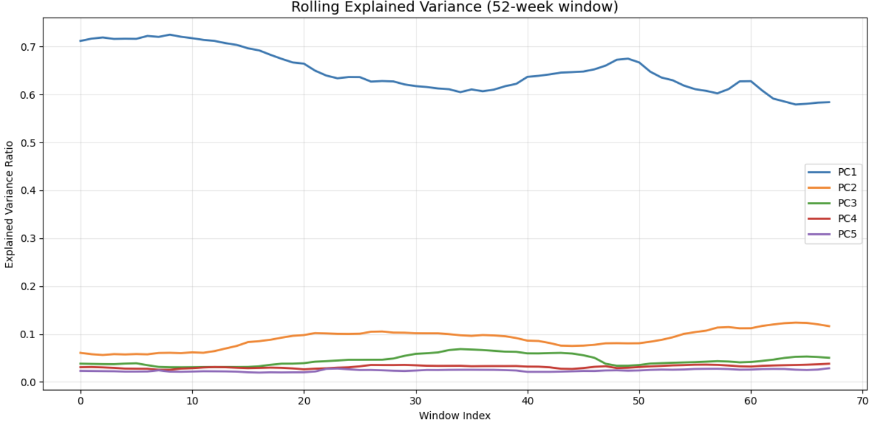
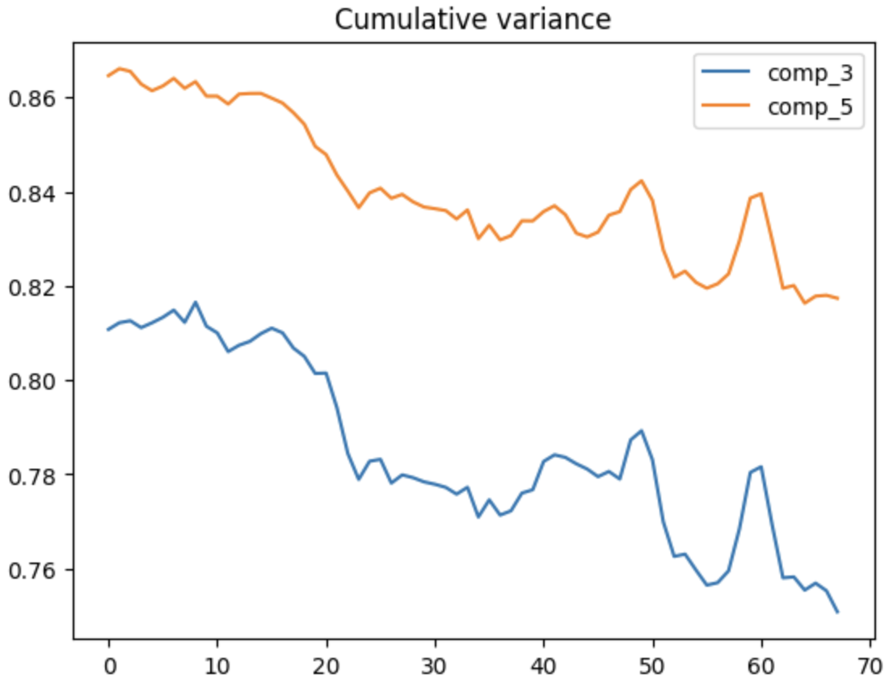
PCA Stability – Rolling Window Analysis
OOS Analysis
To assess stability, PCA was calibrated using a rolling window of 52 weeks.
The first five components showed stable behavior. In particular, the first component explains between 59% and 72% of the variance.
The first three components jointly explain between 75% and 82% of the variance.
This increases to between 83% and 87% when considering the first five components.

Slide 4
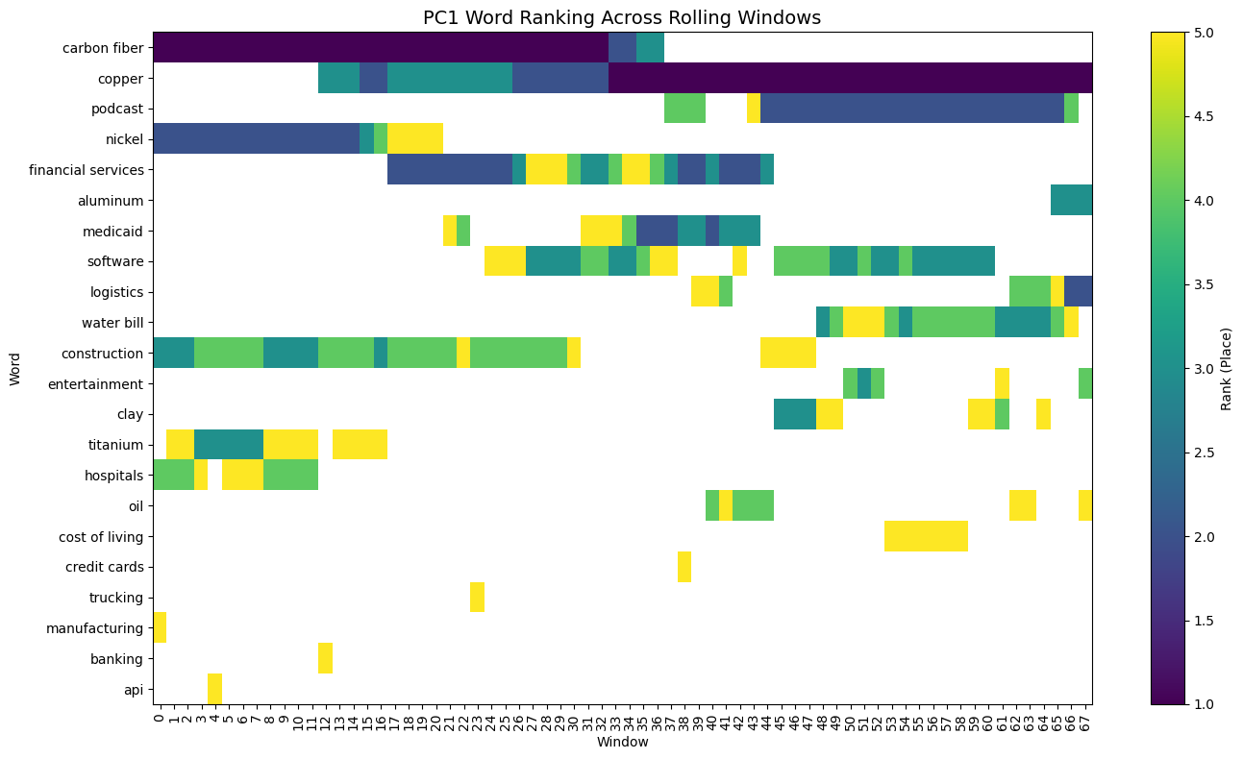
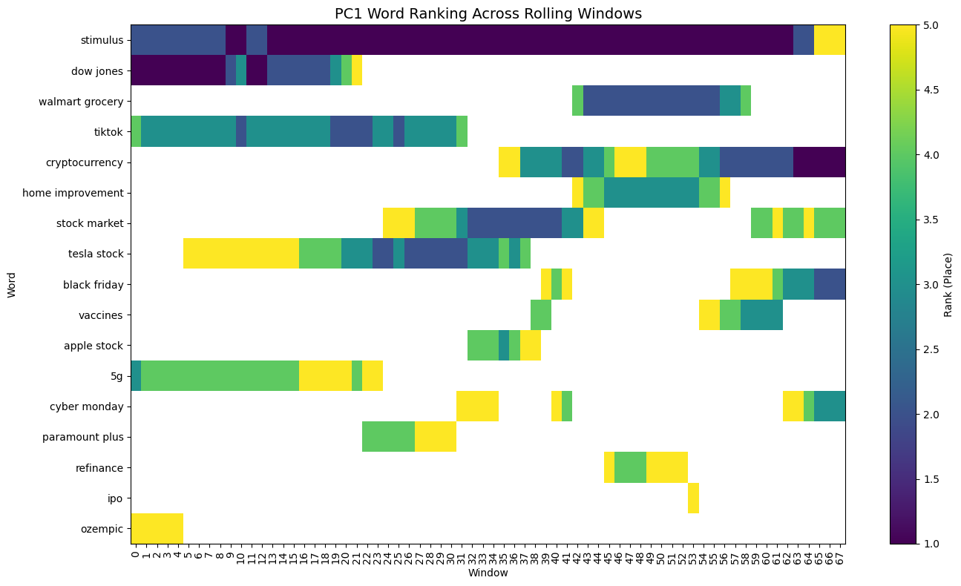
PCA Stability – Rolling Window Analysis
PC1 Loading Interpretation
Positive loadings are primarily concentrated in industrial and commodity-related terms (e.g., copper, nickel, carbon fiber, construction), suggesting a real-economy attention component.
Negative loadings are dominated by consumer, retail, and technology-related terms (e.g., Tesla stock, cryptocurrency, Black Friday, Apple stock, TikTok), reflecting narrative-driven and market-focused attention.
Overall, PC1 captures a structural contrast between industrial/real-economy attention and consumer/technology-driven attention.

Slide 5
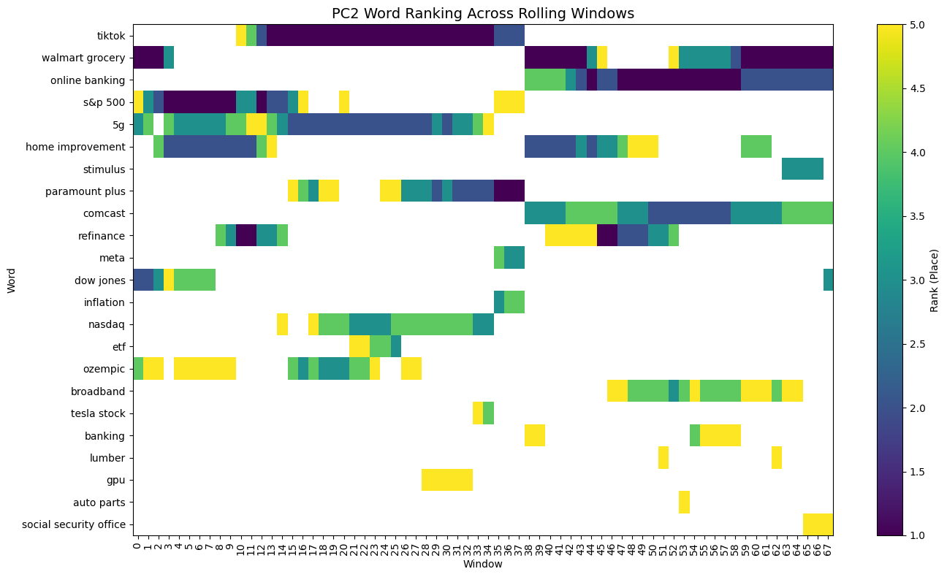
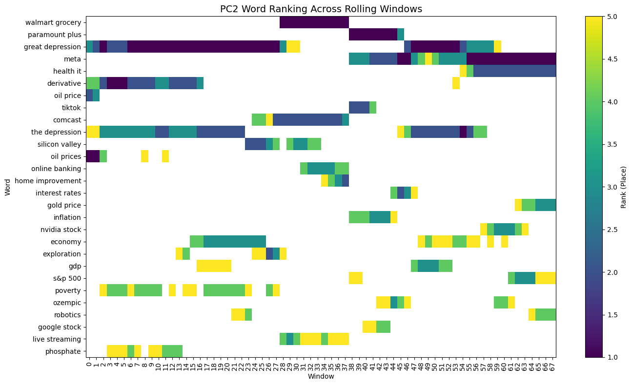
PCA Stability – Rolling Window Analysis
PC2 Loading Interpretation
PC2 shows greater rotation over time compared to PC1, indicating more narrative dynamics.
Positive loadings are dominated by retail, tech, and market-related terms (e.g., Tesla, Nasdaq, ETF, TikTok).
Negative loadings are concentrated in macroeconomic stress terms (e.g., inflation, GDP, interest rates, great depression).
Overall, PC2 captures shifts between market-driven attention and macro stress attention.

Slide 6
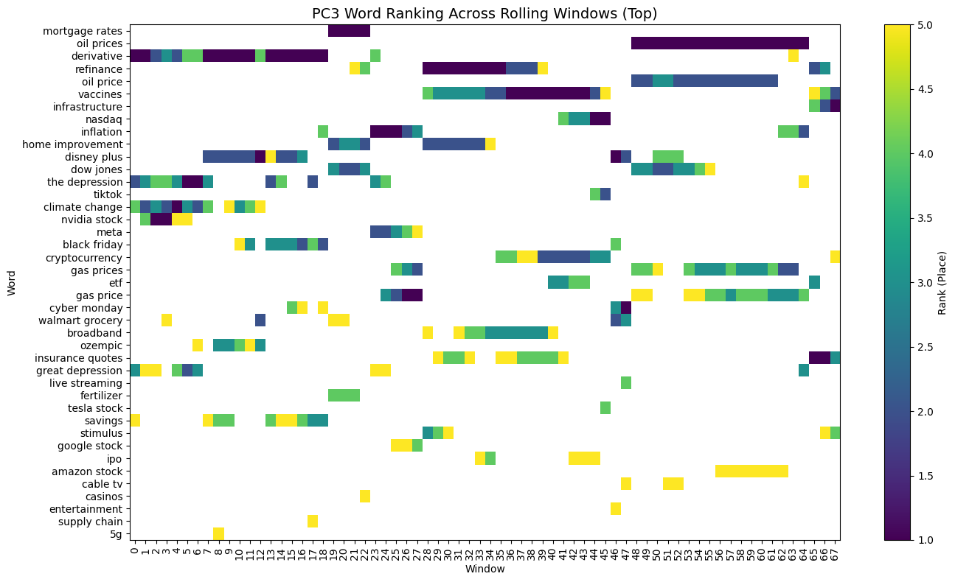
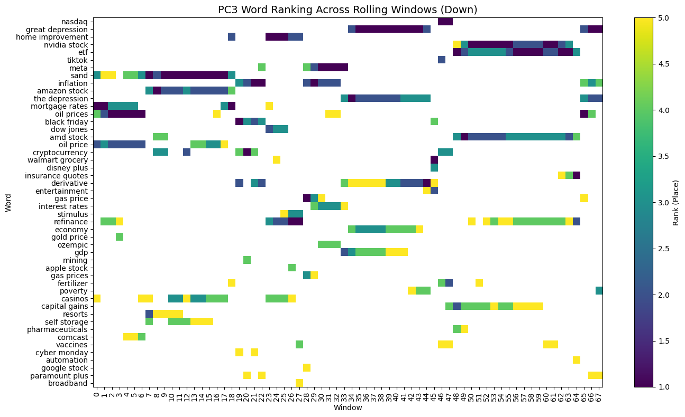
PCA Stability – Rolling Window Analysis
PC3 Loading Interpretation
PC3 shows higher rotation and lower persistence than PC1 and PC2.
Loadings reflect a mixed set of macro, energy, and tech-related terms, without a clear structural theme.
Overall, PC3 appears to capture short-lived narrative shifts or residual attention dynamics.

